Slide 1
Hiding corporate secrets and the willingness to cooperate in public and private antitrust proceedings RUBEN KORSTEN (GHENT UNIVERSITY, BE), ANDREW SAMUEL (LOYOLA UNIVERSITY, MD, US)
centre for advanced studies in law and economics
Presenter: Ruben Korsten, (PhD), 09/21/2019. Prepared for CLEA, Toronto

Slide 2
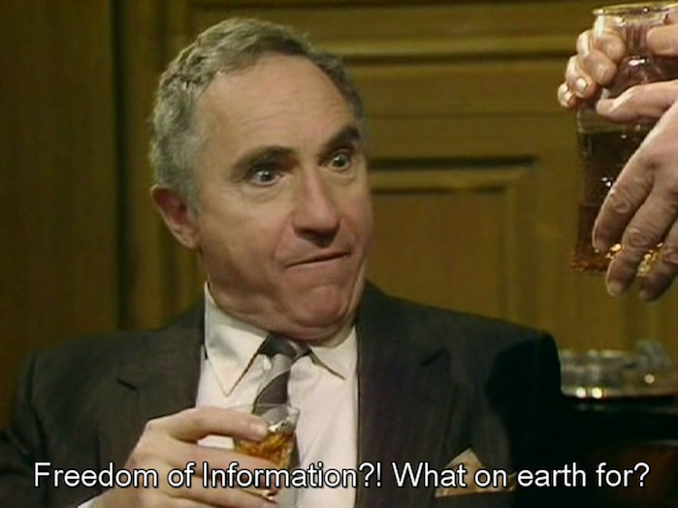
We should always [reveal] anything that they could easily find out some other way.
- Sir Humphrey Appleby (Yes Minister)

Slide 3
Background: leniency policies (I)
Leniency policies and Cartels: A leniency policy offers firms involved in a cartel either total immunity from fines or a reduction of (public) antitrust fines it they voluntarily self-report and hand over evidence concerning the Cartel.
Theoretical analysis: Leniency can deter cartels and lower enforcement costs (Buccirossi et. al (2015), Motta and Polo (2003), Spagnolo (2004), amongst others) and experimental literature (Bigoni et. al 2015, Dijkstra et. al (2011), amongst others)
Thus, leniency is considered the most important investigative tool for detecting cartel activity and it is said to lower enforcement costs

Slide 4
Background: leniency AND DAMAGES
Leniency policies do not per se protect leniency seekers against civil damage suits. Leniency statements actually allow for the recovery of damages, since victims are informed with the existence of a cartel.

Slide 5
Hiding and Corporate Secrets
The current analysis of self-reporting and leniency do not consider the role of hiding and its interaction with corporate secrets
Firms may have incentive to hide to
Conceal self-incriminating evidence regarding the cartel
Avoid revealing commercially sensitive information concerning pricing

Slide 6
Hiding and Corporate Secrets
Thus far we have not studied how leniency interacts with hiding in this context, but we show that hiding is an important factor in this context and has implications for leniency policies.

Slide 7
Background: leniency AND DAMAGES (ii)
Various authors (Buccirossi et. al (2015), Silbye (2011), Basedow (2007) amongst others) have argued that exposure to damages should be minimized for leniency applicants in order to incentivize them to cooperate in the civil procedures. Under such a scheme, leniency should remain attractive, while the victims are fully compensated.
However, we find that:
when a firm self-reports it knows that it will be investigated and that its information will be made public with certainty, whereas when it does not come forward, there is only some probability (<1) with which its cartel is discovered. If the incentive to conceal corporate secrets is strong, then a firm will likely hide more when it self-reports than when it does not.
This ultimately leads to lower damages (because victims have less access to information).
This again leads to lower deterrence, because the total sanctions (fines + damages) are lower.
And wasteful activity: hiding and higher costs of discovery.

Slide 8
The model (I)
Bertrand Oligopoly game with N perfectly symmetrical firms.
Colluding firms receive: ${\text{π}}_{M }=(total monopoly profits$)/N
Deviating firms receive: ${\text{π}}_{D }$ (profitable deviation), with continuation payoffs 0. Further ${\text{π}}_{M }>{\text{π}}_{D }$
Infinitely repeated game
Common discount factor δ
Each period, firms choose to either collude or deviate.
Use the grim trigger strategy to enforce collusion
As is well-known, if δ is sufficiently high, collusion can be sustained.

Slide 9
THE MODEL (II)
Public enforcement and private enforcement are introduced.
Public enforcers audit/inspect firms with probability ρ (0,1]. If the firm is caught colluding they are fined Fn.
If a firm deviates and reports, they are granted leniency so that fines Fr < ρ Fn. Fr under most policies would be 0.
If the firm is caught/reports, they can be sued for damages Dn (if they don't report) or Dr (if they report).
Thus, the total expected sanctions if firms do not report = ρ (Fn + Dn)
and if they report = (Fr + Dr). Dr may be 0 depending on the policy in place.

Slide 10
The model (iii)
Presence of enforcement creates incentives for firms to release or hide evidence. Firms choose a level of hiding (x)
The cost from revealing corporate secrets is I(x), which can be reduced by x. Hence, I'(x) < 0 and I''(x) ≤ 0.
By hiding more evidence damages also can be lowered. Hence, damages (D) are functions of x. [ Dr(x) and Dn(x)]. Note that under full leniency, Dr(x) = 0.
I'(x) is the same for both regimes and D'r(x)=D'c(x).
Hiding costs are given by k(x) = $\frac{x²}{2}$

Slide 11
The model. One-shot payoffs
one-shot payoffs from colluding (C) and not reporting :
payoffs from deviating and reporting (R):

Slide 12
The model. timing
The AA chooses its policies at t=0. From t=1 on, the timing of this stage game in each period is as follows:
[Stage 1.] Firms choose whether to enter into a collusive agreement. If at least one firm chooses not to collude, then the competitive equilibrium is achieved.
[Stage 2.] Firms choose whether to deviate and report (R) and how much to hide or collude (C) and how much to hide
[Stage 3.] Conditional on not reporting in stage 2 the anti-trust authority discovers the cartel with probability ρ. Whereas if the firm has reported in stage 2, the cartel is discovered with probability 1. In either case, the firm is sanctioned (private and public) depending on the leniency policies in place.
[Stage 4.] The game ends, payoffs received and all evidence is destroyed.

Slide 13
The model. Unconditional leniency
Assuming that (1) is violated, a firm that chooses to not report, chooses x to maximize Vc. The first order condition for x:
(1)
Given our assumptions concerning x, there exists an xC that satisfies (1). Similarly, conditional (1) being satisfied x is:
(2)
Let xR that satisfies (2)

Slide 14
The model. Unconditional leniency
The first order condition (1) implies that:
Similarly, the first order condition (2) implies that:
At ρ = 1, xC=xR, therefore, xC < xR for all ρ < 1.
Outcome: providing incentives for reporting (leniency), could encourage more hiding.

Slide 15
The model. Incentives for self-reporting
When condition 1 is satisfied, a firm chooses to report

Slide 16
Hiding and Reporting
Remember, at ρ = 1, xC=xR, therefore, xC < xR for all ρ < 1.
So: hiding is always higher in the reporting case

Slide 17
The model. Expected damages
At ρ = 1 the expected damages are identical regardless of whether Condition 1 is satisfied or violated. When ρ < 1, then if Condition 1 is violated:
Whereas, if Condition 1 is satisfied, then:
Thus, whether expected damages are higher or lower depends on whether $\frac{∂ρD(xN)}{∂ρ} >/<0$
Outcome: it not clear whether or not reporting is beneficial for private enforcement. If reporting is considered beneficial (because it reduces enforcement costs), then incentives for reporting must be structured carefully in order to ensure that excessive hiding under reporting does not offset the gains from reduced enforcement.

Slide 18
EXTENSION: leniency AND DAMAGES
Question(s): Should the liability of leniency applicants be decreased/ Should leniency documents be disclosed in damage suits?
Various jurisdictions have dealt with this dilemma differently over the years.
US approach: more focus on private enforcement. Victims are entitled to full disclosure of the leniency documents, which constitute prima facie evidence in private damage suits. Victims usually only have to prove the harm and the amount of damage. Leniency applicants have the opportunity to cooperate in civil proceedings in order to have their liability reduced from treble to single damages.
EU approach: Since 2014 (Antitrust Damages Actions Directive), leniency documents are fully exempted from the disclosure of evidence. The liability of leniency applicants for damages is also limited.

Slide 19
Intermezzo: In the U.S., leniency documents are made fully available in private proceedings. In Europe it is the opposite. The problem with the U.S. approach is that it makes firms less likely to self report. The problem with the EU approach is that it reduces private enforcement because private parties don't have access to documents. Buccirossi et. al (2015) suggest a blend of the two: give access to private parties, but the firm doesn't have to suffer damages. But this ignores commercial interests - a bit like an externality in this transaction.

Slide 20
Concluding remarks
Previous literature (a.o. Bucirossi et al. (2015); Silbye (2011)): exposure to damages should be minimized for leniency applicants in order to incentivize them to cooperate in the civil procedures in order to lower enforcement and discovery costs and increase effective compensation and deterrence.
However, in our model we show that this presumption cannot hold when we take into account corporate secrets (I(x))
We find that when corporate secrets are taken into account, incentives to hide under self-reporting are high because the information is always revealed (whereas under no reporting regimes, the information is revealed only with some probability). Also, expected damages are not necessarily higher under self-reporting and might be even lower, because victims have less access to evidence.
(Welfare reducing) outcomes: waste of hiding, higher costs of discovery and possibly lower total sanction, resulting in decreased deterrence.
Conclusion: incentives for reporting must be structured carefully in order to ensure that excessive hiding under reporting does not offset these gains from reduced enforcement.
Suggestions: enhanced enforcement presence of the Antitrust Authority (Harrington and Chang (2015) and/or to raise the bar for a successful leniency application (This way, hiding under self-reporting becomes useless, since firms won’t be eligible for a fine reduction when hiding.)

