Slide 1
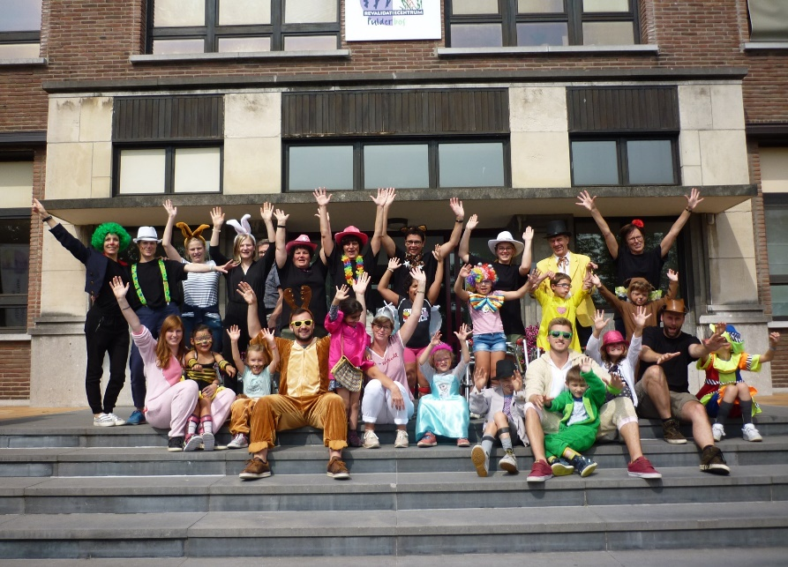
CIRCUSCAMP
The effects of intensive therapy camps for lower limb function and trunk control in children with bilateral CP: preliminary results
van Tittelboom Vanessa¹, Heyrman Lieve^{1,2}, De Cat Jos ², Feys Hilde², Van den Broeck Chris¹
¹ Ghent University, Ghent, Belgium; ² KU Leuven, Leuven, Belgium
Introduction
Intensive interventions for the upper limb in camp models such as CIMT or HABIT have been successfully applied in children with unilateral CP.
In contrast, to our knowledge, no intervention study has yet concomitantly targeted lower limbs and trunk control impairments using an intensive camp model in children with bilateral CP.
Objectives
To investigate the effects of an intensive therapy camp on trunk control and gross motor function outcome measures in children with bilateral spastic CP.
Methods
12 children with bilateral spastic CP (GMFCS II-III, 6-12 years) participated in the study
45h of therapy over 10 days (2 x 5 days/week) were provided
Six functional activities were trained: balance, trunk stability and trunk mobility, standing, walking, transfers, WII.
Both individual and group sessions were provided by trained pediatric physiotherapists
The circus-theme was used to enhance the children’s motivation
Assessment was done at baseline, pre- and post intervention
Outcome measures used:
Gross Motor Function Measure (GMFM) (data of 8 children available)
Trunk Control Measurement Scale (TCMS)
modified Timed Up and Go (mTUG)
1-minute walk test (1MWT)
Results
 | T1 Med (IQR) | T2 Med (IQR) | T3 Med (IQR) | Overall change* (p-value) | T1-T2† (p-value) | T2-T3† (p-value)
GMFM (N=8) Dim C (%) | 93 (71-100) | 94 (71-100) | 94 (71-100) | 0.85
Dim D (%) | 72 (27-88) | 81 (45-87) | 82 (40-87) | 0.42
Dim E (%) | 65 (23-80) | 63 (25-84) | 61 (26-85) | 0.79
Total Dim score (CDE) (%) | 77 (40-89) | 78 (47-90) | 79 (46-91) | 0.42
TCMS (N=12) Static sitting balance (/20) | 14 (8-18) | 14 (10-18) | 15 (13-18) | 0.05 | 0.57 | 0.01
Selective movement control (/28) | 6.5 (4-9.5) | 6.5 (3-10.5) | 9.5 (5-13) | 0.02 | 0.86 | 0.02
Dynamic reaching (/10) | 2 (1-2) | 1.5 (1-2) | 1 (0-2) | 0.16
Total score | 19.5 (15-29.5) | 24 (16-29) | 25 (18-33) | 0.09
mTUG (N=12) (sec) | 10 (7.7-22.1) | 11.8 (7.4-19.6) | 11 (7.2-25.2) | 0.70
1MWT (N=12) (m) | 66 (53-80) | 64 (50-77) | 66 (55-80) | 0.32
T1: baseline; T2:-pre-intervention; T3: post-intervention; Med: median; IQR: Interquartile range; * : Friedman test; † : Wilcoxon signed-rank test; GMFM: Gross Motor Function Measure; Dim: dimension; TCMS: Trunk Control Measurement Scale; mTUG: modified Timed Up and Go; 1MWT: 1-minute walk test
Conclusions
This exploratory study on a limited sample is part of a larger research project on the effects of an intensive therapy camp on trunk control and lower limb function on quantitative and qualitative parameters in children with bilateral spastic CP, conducted between 2017 and 2019.
The preliminary results indicate an improvement after intervention on both static and dynamic aspects of trunk control, while no changes were found on quantitative measures of gross motor function.
Contact:
Vanessa.vantittelboom@ugent.be
0032 (0) 9 332 44 18

