Slide 1



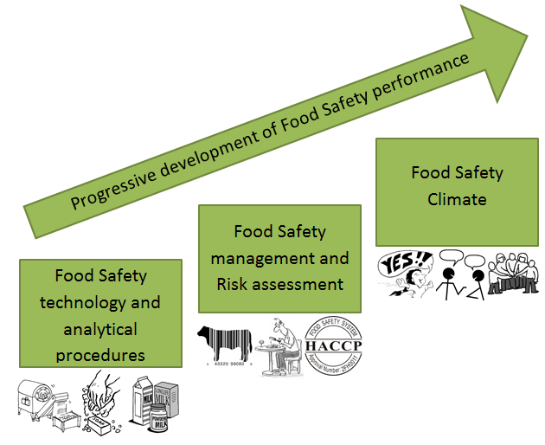
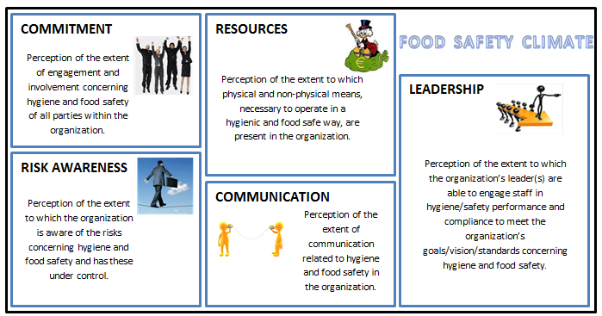
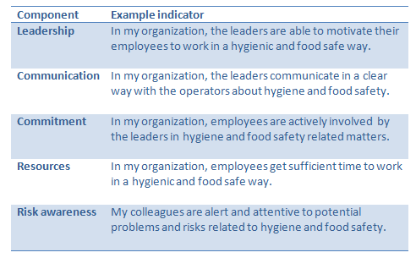
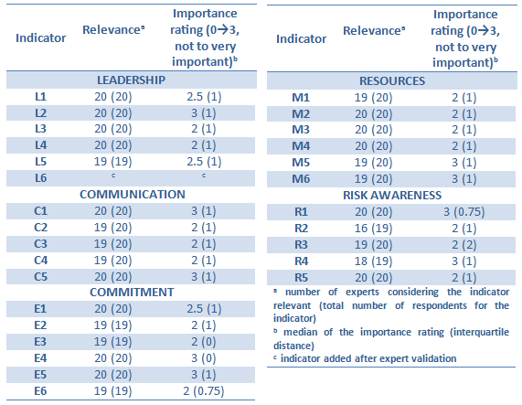
Development and validation of a Food Safety Climate assessment tool
De Boeck E.¹, Jacxsens L.¹, Vlerick P.², Uyttendaele M.¹
¹Laboratory of Food Microbiology and Food Preservation (LFMFP), Department of Food Safety and Food Quality, Faculty of Bio-science engineering, Ghent University, Belgium
²Department of Personnel management, Work and Organizational Psychology, Faculty of Psychology and Educational Sciences, Ghent University, Belgium
INTRODUCTION
Up to now scientific research mainly focused on the development and implementation of analytical capacity, technology and Food Safety Management Systems (FSMS) in food (processing) companies (figure 1). However, in practice, a well elaborated and ‘fit for purpose’ FSMS, does not always guarantee the highest level of food safety and hygiene and a stable system output. This might be due to co-determining factors, such as the Food Safety Climate (FSC) prevailing in the company. Human behavior (e.g. the actual execution of procedures), and decision making is influenced by the perceived Food Safety Climate in an organization.
OBJECTIVE
The goal of this research was to define the concept Food Safety Climate and to develop and validate a tool for the measurement of the Food Safety Climate in food processing companies.
METHOD
The development phase was executed by means of a comprehensive literature study and discussion with experts in the field. Next, twenty other experts with expertise concerning food safety/quality and FSMS, such as governmental agencies (n=4), third party certification bodies (n=3), sector associations (n=3), universities (n=1) and industry (big companies: n=6, small companies: n=3) from Belgium and the Netherlands, were asked to evaluate relevance (adds to the understanding of the concept), reliability (unambiguous and clear) and validity (measures what we want to measure) of our initial Food Safety Climate assessment tool according to the method used by Kirezieva et al. (2013). If 50% or less (n=10) of the experts didn’t consider the question/indicator relevant, the question/indicator was deleted. The experts could also score the importance of each indicator by means of a four-point Likert Scale (not important -> very important; 0 -> 3). Furthermore, open suggestions could be given by the experts for each indicator.
Figure 1: Evolution of research focus towards Food Safety Climate
(Wright et al. 2012)
RESULTS
The terms safety culture and safety climate are often used interchangeably in literature (Wiegmann et al. 2002). In our current research Food Safety Climate is considered as a measured perception of the Food Safety Culture present in a company.
Food Safety Climate is defined as employees’ (shared) perception of the leadership, communication, commitment, resources and risk awareness concerning food safety and hygiene within their current work organization (figure 2). A draft self-assessment survey with 27 indicators was developed at which the respondents can answer by means of a five-point Likert scale (1-> 5, totally disagree -> totally agree). An example of an indicator for each component of Food Safety Climate is given in table 1.
Table 1: Example of an indicator for each component of Food Safety Climate
Figure 2: Components of Food Safety Climate (based on Griffith et al. 2010)
Table 3: Results of the expert validation of the indicators of Food Safety Climate
The results of the expert validation of the initial Food Safety Climate survey are given in table 3. All indicators were deemed relevant for the assessment of the Food Safety Climate by more than half of the experts (n=10). As such, no indicators were considered for deletion. Furthermore, the tool could be considered valid, as the importance rating was above 2 for the majority of the indicators. Based on the suggestions of the experts, some minor adjustments were executed to improve the intelligibility of some indicators and indicator L6 (striving for continuous improvement) was added.
Significance
Our Food Safety Climate assessment tool enables companies to go beyond traditional food safety management and aims to mirror the human dimension in food safety. In further research we want to test our tool in food companies and make a link to microbiological and/or chemical monitoring results and to psychological indicators of the personnel.
References
Griffith, C. J., Livesey, K. M., and Clayton, D. 2010. "The assessment of food safety culture." British Food Journal, 112(4), 439-456.
Kirezieva, K., Nanyunja, J., Jacxsens, L., van der Vorst, J., Uyttendaele, M., and Luning, P. A. 2013. "Context factors affecting design and operation of food safety management systems in the fresh produce chain." Trends in Food Science & Technology, 32(2), 108-127.
Wiegmann, D. A., Zhang, H., Thaden, T. V., Sharma, G., and Mitchell, A. 2002. "A synthesis of Safety Culture and Safety Climate Research." Federal aviation administration Atlantic city International Airport, NJ.
Wright, M., P. Leach, and G. Palmer. 2012. A Tool to Diagnose Culture in Food Business Operators - Report from Greenstreet Berman Ltd for the Food Standards Agency.
For more information:
Tel. +32 9 264.99.02
Fax +32 9 225.55.10
E-mail: Elien.deboeck@UGent.be

