Slide 1



The Effect of Homophily on
Co-Offending Network Structure and Information Diffusion
Ruslan Klymentiev, Luis E C Rocha, Christophe Vandeviver
CBEN & MVE 2024 − Maastricht − 24/10/2024

Slide 2
Research Question
How does similarity-based partner selection affect co-offending network structure and information diffusion?

Slide 3


Research Question
How does similarity-based partner selection affect co-offending network structure and information diffusion?
Stability of partnerships
Skill exchange

Slide 4
Outline
Background
Proposed Agent-Based Model
Results & Discussion

Slide 5



Background
Co-offending acts as a means of achieving material and immaterial goods (Weerman, 2003)*:
  Services
  Catch
  Payment
  Appreciation
  Acceptance
  Information
  * For disorganized/opportunistic crimes
Pros of co-offending
Cons of co-offending
Partner selection
Homophily
Skills exchange

Slide 6
Background
Group crime can increase the risk of getting caught (Morselli, 2009)
As the number of offenders per offense increases the profit per individual offender decreases (Tillyer and Tillyer, 2015)
Non-trivial problem of partner search and selection (McCuish et al., 2015; Tremblay, 2017; Van Mastrigt, 2017; Weerman, 2003)
Pros of co-offending
Cons of co-offending
Partner selection
Homophily
Skills exchange

Slide 7

Background
According to Tremblay (2017), ideally, offenders want to find partners who are trustful and useful.
Trustful connections ensure long-lasting relationships with low chances of failure or betrayal (Grund and Morselli, 2017)
Useful connections provide important information to expand one’s criminal opportunities (Becker and McCorkel, 2011)
Pros of co-offending
Cons of co-offending
Partner selection
Homophily
Skills exchange

Slide 8
Background
Scholars have found similarity preference in co-offending networks in terms of:
age (Bright and Whelan, 2020; Di Meo, 2023; Van Mastrigt and Carrington, 2013)
sex (Di Meo, 2023; Van Mastrigt and Carrington, 2013)
ethnicity (Grund and Densley, 2015)
marital status (Di Meo, 2023)
spatial proximity (Schwarzenbach and Jensen, 2024)
socio-cultural background (Schwarzenbach and Jensen, 2024)
violence level (Geeraert et al., 2024)
Pros of co-offending
Cons of co-offending
Partner selection
Homophily
Skills exchange

Slide 9

Background
Co-offenders commit a wider variety of crimes than solo offenders (Conway and McCord, 2002)
Co-offending often involves a combination of offenders with varying skills (Bright et al., 2024)
Co-offending might help with committing sophisticated crimes (Felson, 2003)
Pros of co-offending
Cons of co-offending
Partner selection
Homophily
Skills exchange

Slide 10
Proposed Model
Overview
Hypotheses
Model algorithm
Parameters
Outcomes
Similarity preference in the environment
Network structure
Information diffusion (Skill sharing)

Slide 11
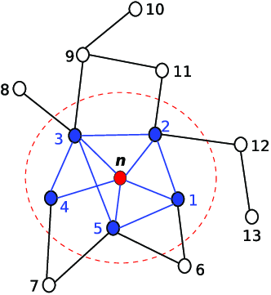
Proposed Model
When co-offenders choose partners who are similar to them, the partnerships become more stable.
When co-offenders choose partners who are similar to them, it decreases the information flow within the network.
Offenders with a lower density (less redundancy) in their ego-centric network learn more skills.
Overview
Hypotheses
Model algorithm
Parameters
Outcomes
Image source: Akabane et al., 2018
Notes:
Less redundant = higher variety
Less redundant = lower density
Higher variety = more skills
low

Slide 12
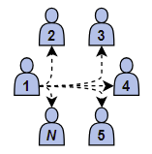
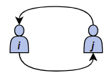
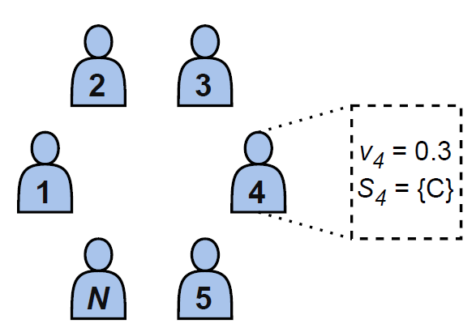
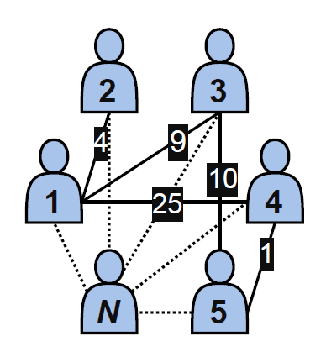

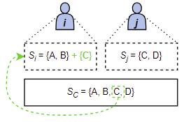

Proposed Model
Overview
Hypotheses
Model algorithm
Parameters
Outcomes
Notes:
Can also be a logistic function with a probability? Can run as a sensitivity analysis

Slide 13
Proposed Model
Overview
Hypotheses
Model algorithm
Parameters
Outcomes
Notes:
Can also be a logistic function with a probability? Can run as a sensitivity analysis

Slide 14
Proposed Model
Overview
Hypotheses
Model algorithm
Parameters
Outcomes
Notes:
Can also be a logistic function with a probability? Can run as a sensitivity analysis

Slide 15
Proposed Model
Overview
Hypotheses
Model algorithm
Parameters
Outcomes
Notes:
Can also be a logistic function with a probability? Can run as a sensitivity analysis

Slide 16
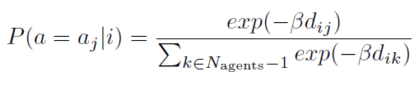

Proposed Model
The probability of selection is based on the softmax function:
Overview
Hypotheses
Model algorithm
Parameters
Outcomes
$d_{ij}=\left|v_{i}−v_{j}\right|$, the dissimilarity between agents i and j
Two scenarios:
  Random partner selection ($β=0$)
  Similarity-based partner selection ($β=50$)

Slide 17

Proposed Model
Network structure:
  Density D, the ratio of existing connections in the network
  Transitivity C, clustering
  Average degree $\overline{k}$, avg. number of partners per offender
  Average tie weight $\overline{w}$, avg. number of repeated interactions
Information diffusion:
  Average number of skills per agents $\overline{S}$
Overview
Hypotheses
Model algorithm
Parameters
Outcomes

Slide 18
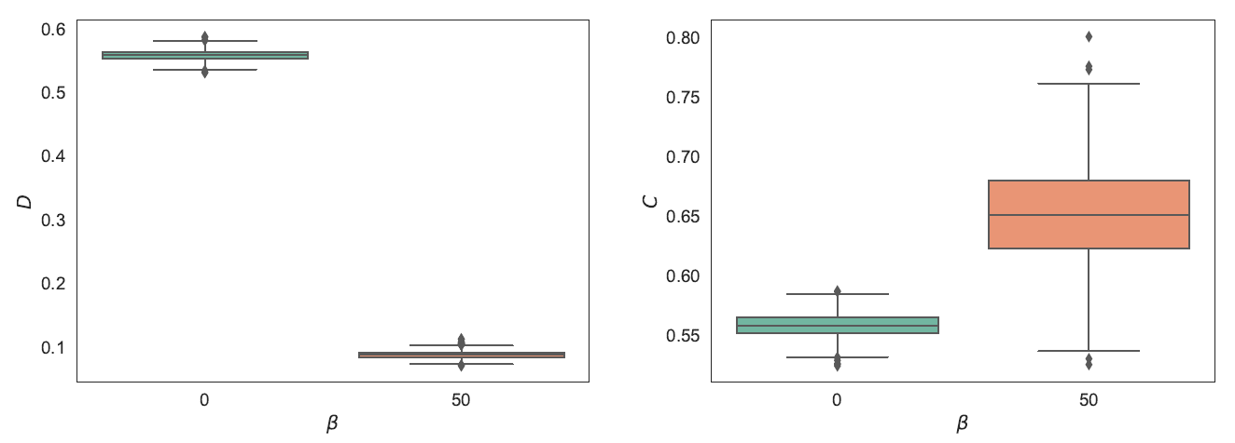

Results
$β=0$: random
$β=50$: similarity-based
Network structure
Information diffusion
Individual-level results
Similarity preference results in denser (left) but more clustered networks (right)

Slide 19
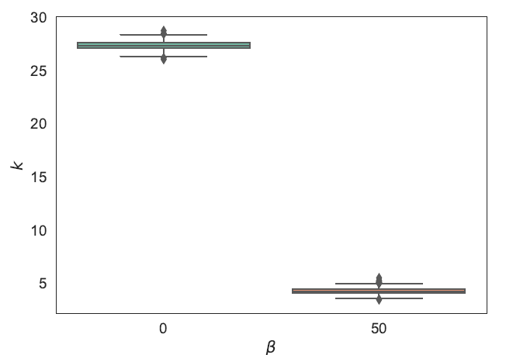
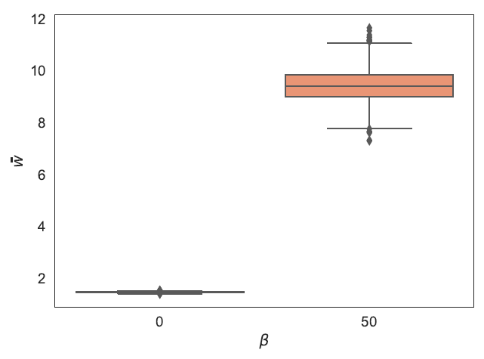
Results
$β=0$: random
$β=50$: similarity-based
Network structure
Information diffusion
Individual-level results
Similarity preference leads to a lower number of partners per offender (left) but these partnerships tend to reoccur more often (right)
✅ H1: When co-offenders choose partners who are similar to them, the partnerships become more stable.

Slide 20
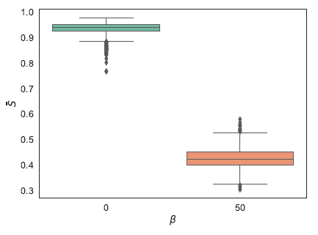
Results
$β=0$: random
$β=50$: similarity-based
Network structure
Information diffusion
Individual-level results
Similarity preference leads to a lower number of skills learned by offenders
✅ H2: When co-offenders choose partners who are similar to them, it decreases the information flow within the network.
Notes:
Change to the average number of crimes per offender
Talk more about the case beta=0?

Slide 21
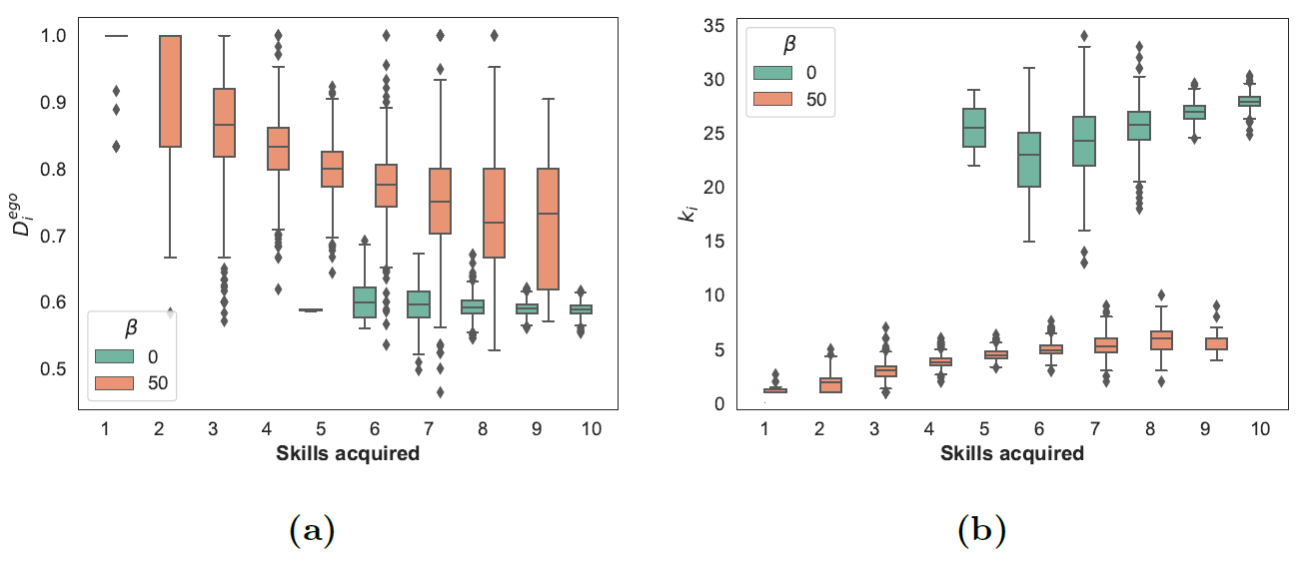
Results
Network structure
Information diffusion
Individual-level results
(✅) H3: Offenders with a lower density (less redundancy) in their ego-centric network learn more skills.
Notes:
- Agents that have a lot of connections are more important for network disruption?

Slide 22
Discussion
When offenders are exclusive during the partner selection process, they develop stable partnerships (strong ties). This in turn results in a low number of skills acquired by offenders
When offenders are more inclusive, they learn new skills from each other to a greater extent. However, this comes with the consequences of having fewer stable connections (weak ties)
Long-term criminal partners tend to specialize (Grund and Morselli, 2017)
Make the model more complex (e.g., different attributes, triadic closure, degree assortativity?)
By identifying how homophily drives network formation and skills exchange, policymakers can design more targeted interventions that disrupt these processes (Diviak, 2023)

Slide 23
Ruslan Klymentiev
PhD Researcher
Department of Criminology, Criminal Law and Social Law
Institute for International Research on Criminal Policy
Campus Aula, Universiteitstraat 4, 9000 Ghent, Belgium email: Ruslan.Klymentiev@UGent.be

Slide 24
References
Becker, S., & McCorkel, J. A. (2011). The Gender of Criminal Opportunity: The Impact of Male Co-Offenders on Women’s Crime. Feminist Criminology, 6 (2), 79–110. https://doi.org/10.1177/1557085110396501
Bright, D., Lerner, J., Putra Sadewo, G. R., & Whelan, C. (2024). Offence versatility among co-offenders: A dynamic network analysis. Social Networks, 78, 1–11. https://doi.org/10.1016/j.socnet.2023.10.003
Di Meo, G. (2023). Historical Co-offending Networks: A Social Network Analysis Approach. The British Journal of Criminology, 63 (6), 1591–1611. https://doi.org/10.1093/bjc/azad00516
Diviak, T. (2023). Structural resilience and recovery of a criminal network after disruption: A simulation study. Journal of Experimental Criminology. https://doi.org/10.1007/s11292-023-09563-z
Felson, M. (2003). The process of co-offending. Crime prevention studies, 16, 149–168.
Furutani, S., Shibahara, T., Akiyama, M., & Aida, M. (2023). Analysis of Homophily Effects on Information Diffusion on Social Networks. IEEE Access, 11, 79974–79983. https://doi.org/10.1109/ACCESS.2023.3299854
Geeraert, J., Rocha, L. E., & Vandeviver, C. (2024). The impact of violent behavior on co-offender selection: Evidence of behavioral homophily. Journal of Criminal Justice, 94, 102259. https://doi.org/10.1016/j.jcrimjus.2024.102259
Grund, T. U., & Densley, J. A. (2015). Ethnic Homophily and Triad Closure: Mapping Internal Gang Structure Using Exponential Random Graph Models. Journal of Contemporary Criminal Justice, 31 (3), 354–370. https://doi.org/10.1177/1043986214553377
Grund, T. U., & Morselli, C. (2017). Overlapping crime: Stability and specialization of co-offending relationships. Social Networks, 51, 14–22. https://doi.org/10.1016/j.socnet.2017.03.008
Morselli, C. (2009). Inside Criminal Networks (Vol. 8). Springer New York. https://doi.org/10.1007/978-0-387-09526-4
Tillyer, M. S., & Tillyer, R. (2015). Maybe I Should Do This Alone: A Comparison of Solo and Co-offending Robbery Outcomes. Justice Quarterly, 32 (6), 1064–1088. https://doi.org/10.1080/07418825.2014.883422
McCuish, E. C., Bouchard, M., & Corrado, R. R. (2015). The Search for Suitable Homicide Co-Offenders Among Gang Members. Journal of Contemporary Criminal Justice, 31 (3), 319–336. https://doi.org/10.1177/1043986214553375
Schwarzenbach, A., & Jensen, M. (2024). Extremists of a feather flock together? Community structures, transitivity, and patterns of homophily in the US Islamist co-offending network (K. L. Warren, Ed.). PLOS ONE, 19 (6), e0298273. https://doi.org/10.1371/journal.pone.0298273
Talaga, S., & Nowak, A. (2020). Homophily as a Process Generating Social Networks: Insights from Social Distance Attachment Model. Journal of Artificial Societies and Social Simulation, 23 (2), 6. https://doi.org/10.18564/jasss.4252
Tremblay, P. (2017, October). Searching for Suitable Co-offenders. In R. V. Clarke & M. Felson(Eds.), Routine Activity and Rational Choice (1st ed., pp. 17–36). Routledge. https://doi.org/10.4324/9781315128788-2
Van Mastrigt, S. B. (2017, June). Co-offending and Co-offender Selection (W. Bernasco, J.-L. Van Gelder, & H. Elffers, Eds.; Vol. 1). Oxford University Press. https://doi.org/10.1093/oxfordhb/9780199338801.013.21
Van Mastrigt, S. B., & Carrington, P. J. (2013, October). Sex and Age Homophily in Co-offending Networks: Opportunity or Preference? In Crime and Networks (pp. 40–63).
Weerman, F. M. (2003). Co-offending as Social Exchange. Explaining Characteristics of Co-offending. British Journal of Criminology, 43 (2), 398–416. https://doi.org/10.1093/bjc/43.2.398

Slide 25
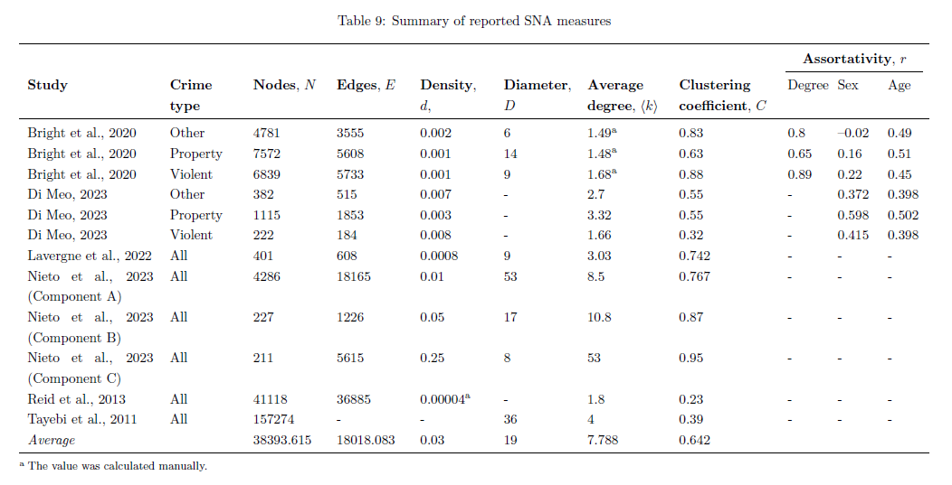
Backup Slides

Slide 26
Backup Slides

Slide 27
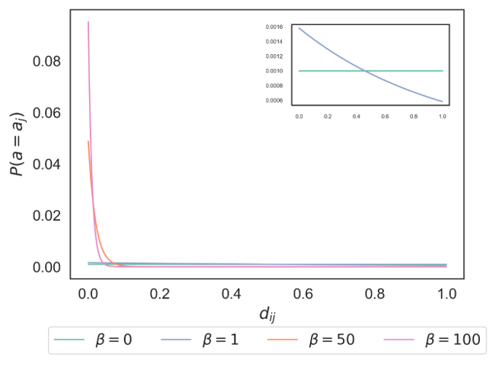
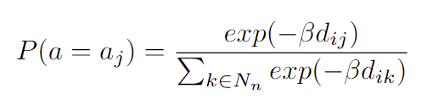
Backup Slides

Slide 28
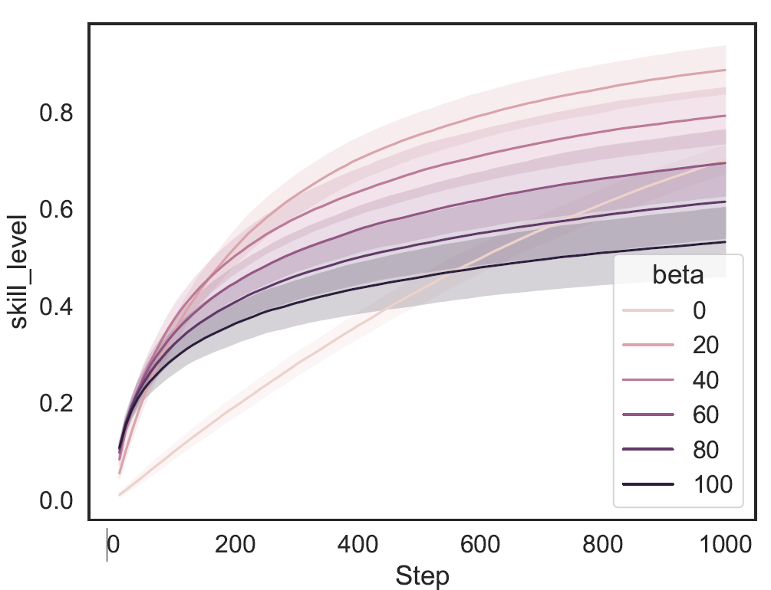
Backup Slides

Slide 29
Background
Homophily plays an important role in:
network formation (Alraddadi et al., 2020; Talaga and Nowak, 2020)
information diffusion (Furutani et al., 2023; Golub and Jackson, 2012; Sun et al., 2022)
opinion formation (Alraddadi et al., 2020; Gargiulo and Gandica, 2017)
innovations in networks (Yousaf and Palazzo, 2023)
Pros of co-offending
Cons of co-offending
Partner selection
Homophily
Skills exchange

